Slide 1
Compiler Design
Chapter 5
SYNTAX Directed translation

Slide 2
Inherited Attributes
Inherited Attributes: They are computed from the values of the attributes of the siblings and the parent nodes.
An inherited attribute at node N, is defined in terms of attribute values at N’s parent, N’s siblings and from N itself.
For Top Down Parsing,
T→ F T’
T’→* F T’
T’→ε
F→ digit
Draw Annotated Parse Tree for 3*5

Slide 3
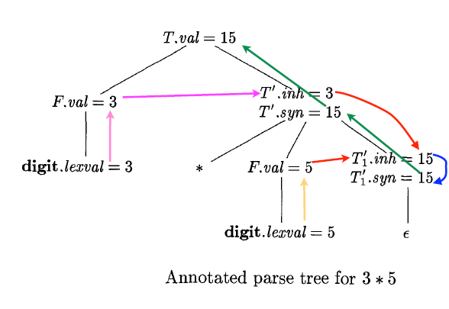
Annotated Parse Tree for 3*5

Slide 4
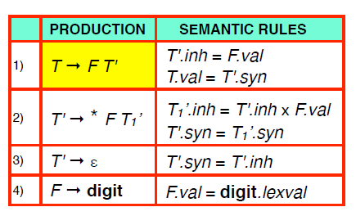
L-Attributed Definition

Slide 5
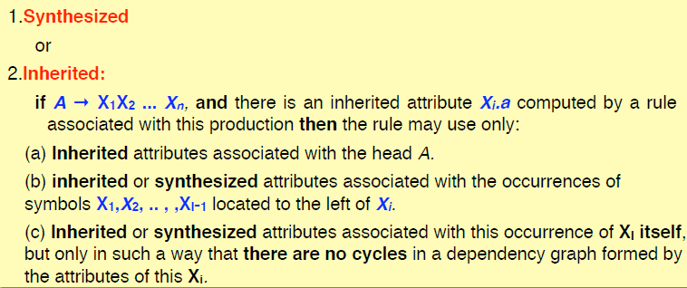
L-Attributed Definitions
A SDD is L-attributed if the edges in the dependency graph goes from Left to Right but not from Right to Left.
More precisely, each attribute must be either

Slide 6
Another Example:
D→ B D’
D’→B D’
D’→ε
B→0
B→1
Generate L-attributed Definition for the Grammar

Slide 7
L-Attributed Definition
Production | Semantic Rules
D→ B D’ | D.val=D’.syn D’.inh=B.val
D’→B D’1 | D’1.inh=D’.inh*2+B.val D’.syn=D’1.syn
D’→ε | D’.syn=D’.inh
B→0 | B.val=0
B→1 | B.val=1

